Slide 1
Delta MRO Engine Simulation Packaging
Summer 2024 Progress
Madeleine Graham Macy
Updated 8/7/2024

Slide 2
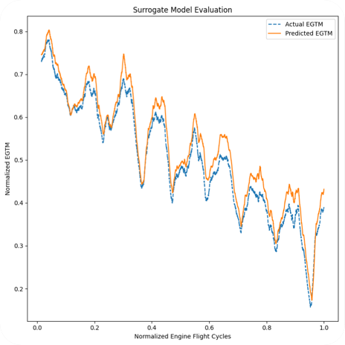
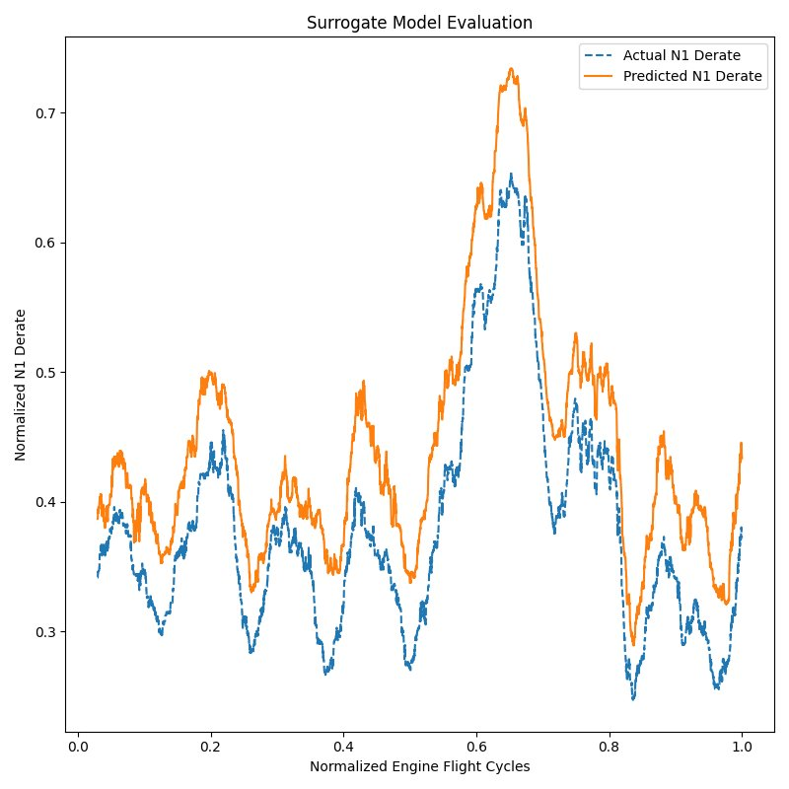
DREAM Legacy
Neural Net Modeling of N1 Derate and EGTM
OAT
Altitude
TOGW
Runway Length
N1 Derate
Predicted EGTM
Past Cycles

Slide 3
Codebase Refactoring
Object-oriented in Python
Code clarity
Naming schemes using units, everything documented with git logs concise
Reduced lines of code by ~60 percent
Improved performance
An 8-hour, multi-computer simulation now runs in only a few hours
Scalable fleets
Able to fully replicate a Delta-like 737-800 fleet, easily scalable for the future to other dash numbers, other engines, other planes
Scalable scheduling logic
Able to simulate operations with a schedule that changes depending on logic
More airports
Over 80 airports in North and Central America now represented

Slide 4
Modular Object-Oriented Code
R Engine 1
Fleet
Aircraft 1
L Engine 1
Airport
R Engine 2
Aircraft 2
L Engine 2
Airport
R Engine 3
Aircraft 3
L Engine 3
Airport

Slide 5
Modular Object-Oriented Code Example
12 pm UTC
5 pm UTC
8 pm UTC
Aircraft 1
Located in ATL
flies to SFO
Aircraft 1
Located in SFO
Log AOG in SFO
Aircraft 1
Located in SFO
R Eng 1
degrades
R Eng 1
Low EGTM alert
swap
R Eng 36232
L Eng 1
degrades
L Eng 1
L Eng 1
Now Aircraft 1 has a different engine and will continue to use airport information to degrade its engines while flying to its destinations.

Slide 6
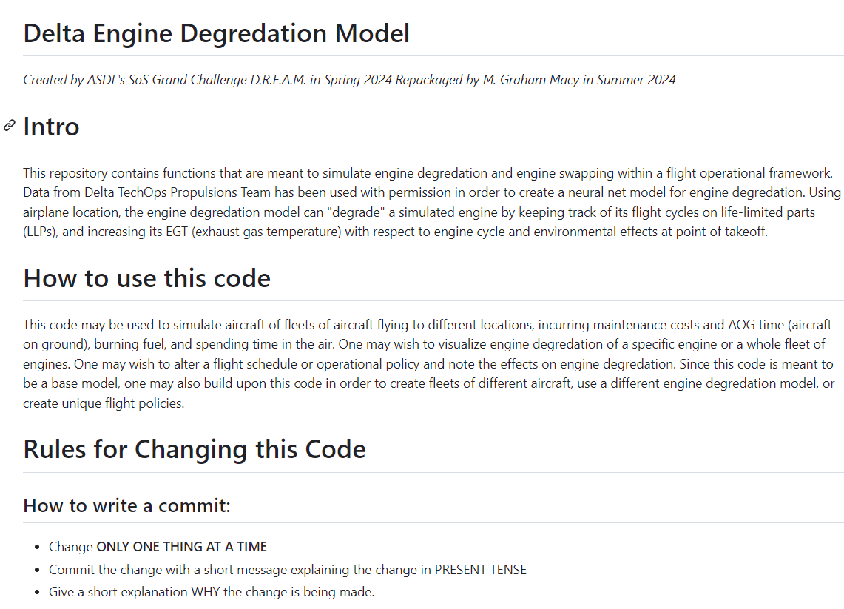
Handover for next Grand Challenge
Github Repo to be shared
README.md containing rules and explanation of functions
Hosted on my student account
https://github.gatech.edu/mgraham46/Delta_Engine_MRO/tree/main

